Slide 1
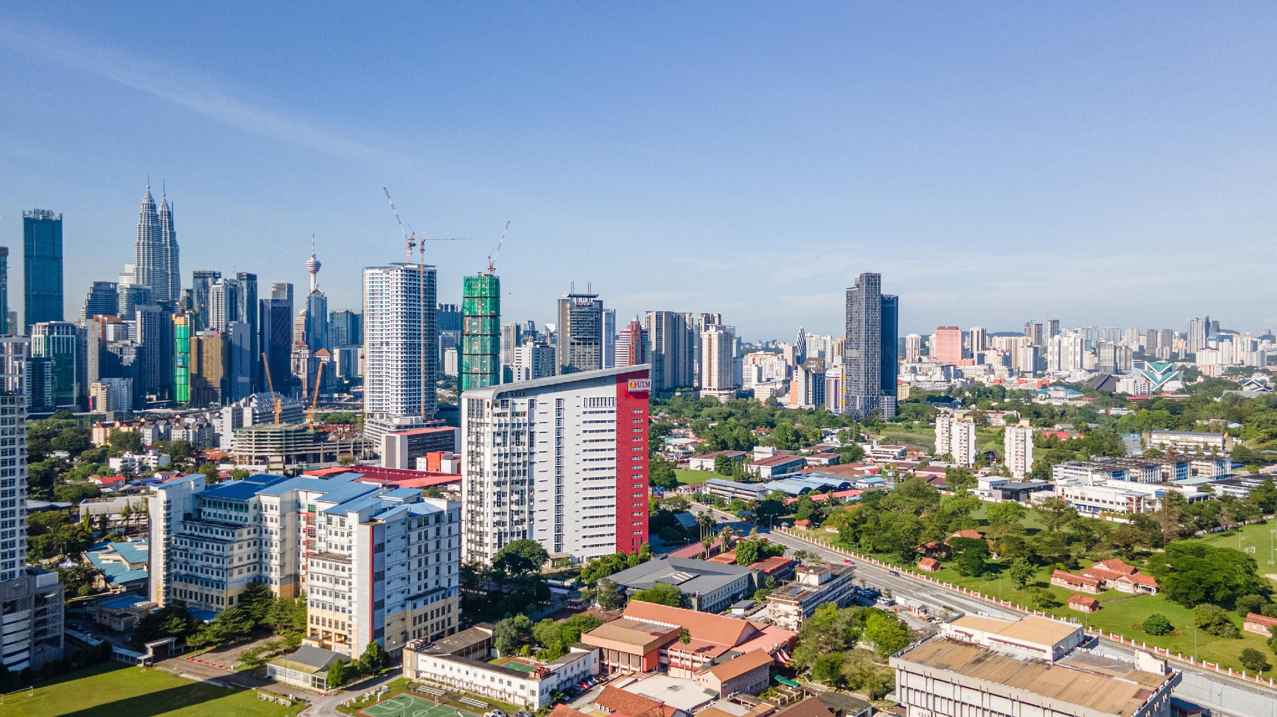

SECI1143
Probability & statistical data analysis
CHAPTER 4
Overview of Probability
Innovating Sustainable Solutions
Notes:
prepared by Razana Alwee / edited by Suhaila Mohamad Yusuf

Slide 2


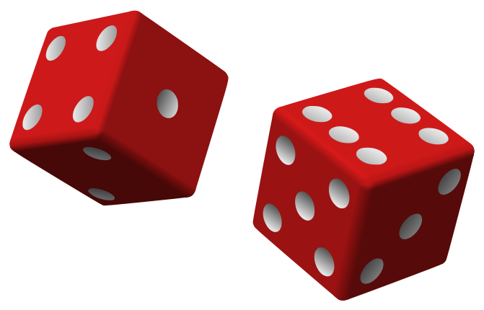
Probability
(Recall from subject SCSI1013 – Discrete Mathematics: Chapter 3 (Part 4 – probability theory)
Probability – the systematic study of uncertainty.
Example of activities involve with uncertainty:
Rolling a dice
Tossing a coin
Select cards from deck

Slide 3
Basic of Probability
Experiment (an activity with an observable result / outcome).
Outcome (the result of obtained from an experiment).
Sample space (the set of all possible outcomes or sample points of an experiments).
Event (subset of sample space).

Slide 4
Chance Experiments
Suppose:
two six-sided dice is rolled and they both land on sixes.
a coin is flipped and it lands on heads.
These would be examples of chance experiments.
A chance experiment is any activity or situation in which there is uncertainty about which of two or more plausible outcomes will result.

Slide 5
Sample Space
Suppose a six-sided dice is rolled. The possible outcomes are that the dice could land with 1 dot up or 2, 3, 4, 5, or 6 dots up.
S = {1, 2, 3, 4, 5, 6}
This would be an example of a sample space (S).
The collection of all possible outcomes of a chance experiment is the sample space for the experiment.

Slide 6

Suppose two coins are flipped. The sample space would be:
S = {HH, HT, TH, TT} ; H = heads and T = tails
We can also use a tree diagram to represent a sample space.
H
H
T
HT
H
T
T

Slide 7
Event
Example: The car purchase chance experiment has a sample space:
S = {MH, FH, MT, FT} ;
where M=male, F=female, H=hybrid, T= traditional.
We might focus on a group of outcomes that involve the purchase of a hybrid – the group consisting of (male, hybrid) and (female, hybrid).
When we combine one or more individual outcomes in a collection, we are creating what is known as event.
An event is any collection of outcomes from the sample space of a chance experiment.

Slide 8
Complement, Union & Intersection
Let A and B denote two events.
The event not A (or complement of A) consists of all experimental outcome that are not in event A, denoted by

Slide 9
The event A or B (or the union of two events) consists of all experimental outcome that are in at least one of the two events, that is, in A or in B or in both of these, denoted by
The event A and B (or the intersection of two events) consists of all experimental outcome that are in both A and B, denoted by

Slide 10
Example - Complement
Suppose a six-sided dice is rolled. The event that the dice would land on an even number would be
E = {2, 4, 6}
What would the event be that is the dice NOT landing on an even number?
E^{C} = {1, 3, 5}
The sum of the probabilities of complementary events equals ONE.

Slide 11
Example - Union
Suppose a six-sided dice is rolled. The event that the dice would land on an even number would be
E = {2, 4, 6}
The event that the dice would land on a prime number would be
P = {2, 3, 5}
What would be the event E or P happening?
E or P = {2, 3, 4, 5, 6}
11

Slide 12
Example - Intersection
Suppose a six-sided dice is rolled. The event that the dice would land on an even number would be
E = {2, 4, 6}
The event that the dice would land on a prime number would be
P = {2, 3, 5}
What would be the event E and P happening?
E and P = {2}
12

Slide 13
Venn Diagram
Let’s revisit rolling a dice and getting an even or a prime number . . . E or P = {2, 3, 4, 5, 6}
Another way to represent this is with a Venn Diagram.
Even number
Prime number
4
3
2
1
6
5
Why is the number 1 outside the circles?
13

Slide 14
Approach to Probability
When the outcomes in a sample space are equally likely, the probability of an event E, denoted by P(E), is the ratio of the number of outcomes favorable to E to the total number of outcomes in the sample space.
Examples: flipping a coin, rolling a dice, etc.

Slide 15
Probability - Rules
Fundamental Properties of Probability
Property 1. Legitimate Values
For any event E,
0 < P(E) < 1
Property 2. Sample space
If S is the sample space,
P(S) = 1

Slide 16
Property 3. Addition
If two events E and F are disjoint,
P(E or F) = P(E) + P(F)
Property 4. Complement
For any event E,
P(E) + P(not E) = 1

Slide 17
Exercise #1
The student council for a school of science and math has one representative from each of the five academic departments: Biology (B), Chemistry (C), Mathematics (M), Physics (P), and Statistics (S). Two of these students are to be randomly selected for inclusion on a university-wide student committee (by placing five slips of paper in a bowl, mixing and drawing out two of them).
What are the 10 possible outcomes?
From the description of the selection process, all outcomes are equally likely. What is the probability of each event?
What is the probability that one of the committee members is the statistics department representative?
What is the probability that both committee members come from laboratory science departments?

Slide 18
Exercise #2
A large department store offers online ordering. When a purchase is made online, the customer can select one of four different delivery options: expedited overnight delivery, expedited second-business-day delivery, standard delivery, or delivery to the nearest store for customer pick-up. Consider the chance experiment that consists of observing the selected delivery option for a randomly selected online purchase.
a) What are the events that make-up the sample space for this experiment?
b) Suppose that the probability of an overnight delivery selection is 0.1, the probability of a second-day delivery selection is 0.3, and the probability of a standard-delivery selection is 0.4. Find the following probabilities:
The probability that a randomly selected online purchase selects delivery to the nearest store for customer pick-up.
The probability that the customer selects a form of expedited delivery.
The probability that either standard delivery or delivery to the nearest store is selected.

Slide 19
SCSI2143: probability & statistical data analysis
CHAPTER 4
(Part 2)
Random Variables & Probability Distribution

Slide 20
Random Variables
A numerical variable whose value depends on the outcome of a chance experiment.
It associates a numerical value with each outcome of a chance experiment.
Two types of random variables
Discrete
Continuous
20

Slide 21
Discrete Random Variables
Discrete – its set of possible values is a collection of isolated points along a number line.
Continuous - its set of possible values includes an entire interval on a number line.
This is typically a “count” of something
This is typically a “measure” of something
21

Slide 22

Example
Suppose that a counsellor plans to select a random sample of 50 seniors at a large high school and to as each student in the sample whether he or she plans to attend college after graduation. The process of sampling is a chance experiment. The sample space for this experiment consists of all different possible random samples of size 50 that might result (there is a very large number of these) and for simple random sampling, each of these outcomes is equally likely.
Let x is the random variable.
x represent the number of successes in the sample (who plans to attend college after graduation).
Thus, x is discrete random variable (counting).

Slide 23

Example
A point is randomly selected on the surface of a lake that has a maximum depth of 100 feet. Let y be the depth of the lake at the random chosen point.
The possible value of y : measurement in feed of the depth of the lake.
Thus, y is continuous random variable.

Slide 24
Example
Consider an experiment in which the type of book, print (P) and digital (D), chosen by each of three successive customers making a purchase from on an online bookstore is noted. Define a random variable x by
The experimental outcome can be abbreviated, e.g., DPD (first and third customer purchase a digital book).
There are only 4 possible x values: 0, 1, 2 and 3. Thus, x is discrete random variable.
Outcome | PPP | DPP | PDP | PPD | DDP | DPD | PDD | DDD
x value | 0 | 1 | 1 | 1 | 2 | 2 | 2 | 3
24

Slide 25
Probability Distribution For Discrete Random Variables
25

Slide 26
Definition
Probability distribution is a model that describes the long-run behaviour of a variable.
The mathematical definition of a discrete probability distribution is : p(x)
If x = 2, we write p(2) in place of p(x=2)
p(5) denotes the probability that x = 5.

Slide 27
It give the possibility associated with each possible x value.
Each probability is the long-run relative frequency of occurrence of the corresponding x value when the chance experiment is performed a very large number of times.
Common way to display a probability distribution for discrete random variable: table, histogram, formula.
27

Slide 28
Example
In a Wolf City, regulations prohibit no more than five dogs or cats per household.
Let, x = the number of dogs and cats in a randomly selected household in Wolf City.
Then, the Department of Animal Control has collected data over the course of several years. They want to estimate the long-run probabilities for the values of x.
28

Slide 29
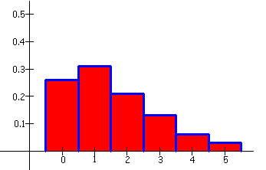
The results as follows:
x 0 1 2 3 4 5
p(x) 0.26 0.31 0.21 0.13 0.06 0.03
This is called a discrete probability distribution. It can also be displayed in a histogram with the probability on the vertical axis.
Probability
Number of Pets
29

Slide 30
Properties of Discrete Probability Distributions
1) For every possible x value,
0 < p(x) < 1.
2)

Slide 31
Example
Refer to previous example (Dogs and Cats) .
What is the probability that a randomly selected household in Wolf City has at most 2 pets?
x 0 1 2 3 4 5
p(x) 0.26 0.31 0.21 0.13 0.06 0.03
p(x < 2) =
0.26 + 0.31 + 0.21 = 0.78
31

Slide 32
x 0 1 2 3 4 5
p(x) 0.26 0.31 0.21 0.13 0.06 0.03
What is the probability that a randomly selected household in Wolf City has less than 2 pets?
p(x < 2) =
0.26 + 0.31 = 0.57
32

Slide 33
x 0 1 2 3 4 5
p(x) 0.26 0.31 0.21 0.13 0.06 0.03
What is the probability that a randomly selected household in Wolf City has more than 1 but no more than 4 pets?
p(1 < x ≤ 4) =
0.21 + 0.13 + 0.06 = 0.40
33

Slide 34
Probability Distribution For Continuous Variables
34

Slide 35
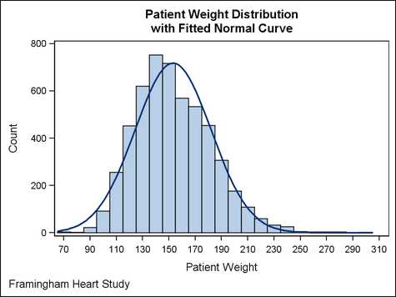
Definition : Continuous Random Variable
Continuous Variables Probability Distribution
A continuous random variables is a random variable where the data can take infinitely many values.
A continuous random variable “x” takes all values in a given interval of numbers.

Slide 36
Definition : Probability Distribution for Continuous Random Variable
It is specified by a curve called a density curve.
The function that describes this curve is denoted by f(x) and is called the density function.
The probability of observing a value in a particular interval is the area under the curve and above the given interval.

Slide 37
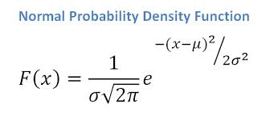

Continuous Variables Probability Distribution
Density curve
Density function
Probability

Slide 38
Properties of Continuous Probability Distributions
1. f(x) > 0 (the curve cannot dip below the horizontal axis).
2. The total area under the density curve equals one.
38

Slide 39
Example
Suppose x is a continuous random variable defined as the amount of time (in minutes) taken by a clerk to process a certain type of application form. Suppose x has a probability distribution with density function:
The following is the graph of f(x), the density curve:
Density
Time (in minutes)
39

Slide 40
Example (cont.)
What is the probability that it takes more than 5.5 minutes to process the application form?
p(x > 5.5) =
0.5(0.5) = 0.25
Density
Time (in minutes)
40

Slide 41
Other Density Curves
Some density curves resemble the one below. Integral calculus is used to find the area under the these curves.
We will use tables (with the values already calculated).
41

Slide 42
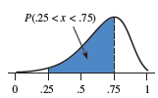
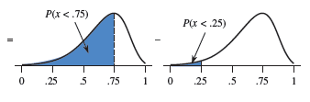
The probability that a continuous random variable x lies between a lower limit a and an upper limit b is
p(a < x < b) = (cumulative area to the left of b) – (cumulative area to the left of a)
p(a < x < b) = p(x < b) – p(x < a)
42

Slide 43
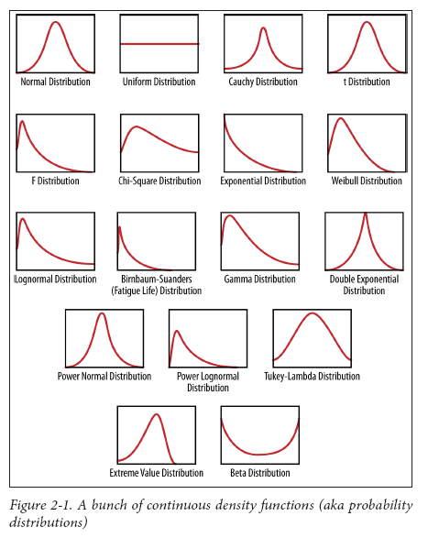
Other continuous
distribution
We will use tables for certain distribution (with the values already calculated).
43

Slide 44
SCSI2143: probability & statistical data analysis
CHAPTER 4
(Part 3)
Discrete & Continuous Probability Distribution

Slide 45
Special Distributions
Discrete Distribution:
Binomial
Negative Binomial
Geometric
Continuous Distribution:
Normal

Slide 46
Discrete Distribution
46

Slide 47
Binomial Distribution
An experiments often consists of repeated trials, each with two possible outcomes that may be labeled success or failure.
Example: The testing items as they come off an assembly line, where each trial may indicate a defective or a non-defective item.
The process is referred to as a Bernoulli process.
Each trial is called a Bernoulli trial.
47

Slide 48
Binomial Distribution
Suppose we decide to record the gender of the next 25 newborns at a particular hospital.
What is the chance that at least 15 are female?
What is the chance that between 10 and 15 are female?
Out of the 25 newborns, how many can we expect to be female?

Slide 49
Properties of a Bernoulli process:
Binomial Distribution (cont’d)
There are a fixed number of trials.
Each trial results in one of only two possible outcomes, labeled success (S) or failure (F).
Outcomes of different trials are independent.
The probability that a trial results in success is the same for all trials.
49

Slide 50
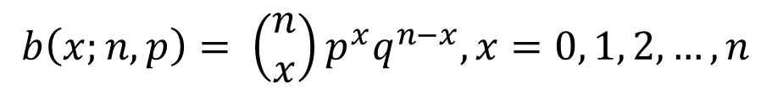

Binomial Distribution (cont’d)
The number X of success in n Bernoulli trials is called a binomial random variable.
The probability distribution of this discrete random variable is called the binomial distribution.
Formula:
A Bernoulli trial can result in a success with probability p and a failure with probability q = 1-p. Then the probability distribution of the binomial random variable X, the number of successes in n independent trials, is
The mean and variance of the binomial distribution:
50

Slide 51
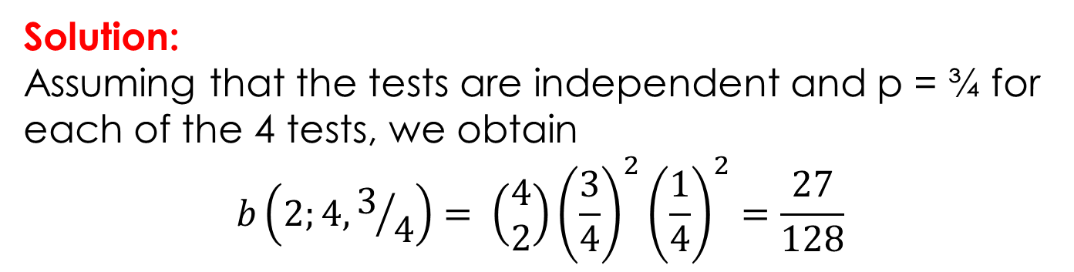
Example
The probability that a certain kind of component will survive a shock test is ¾. Find the probability that exactly 2 of the next 4 components tested survive.
51

Slide 52
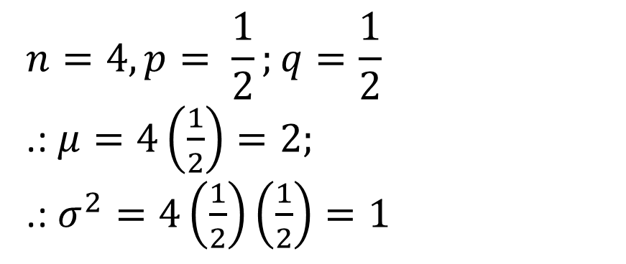
Example
A coin is tossed four times. Find the mean and variance of the number of heads that will be obtained? Given the distribution as follows.
No of head, x | 0 | 1 | 2 | 3 | 4
Probability | 1/16 | 4/16 | 6/16 | 4/16 | 1/16
Solution:
52

Slide 53
Negative Binomial Distribution
If repeated independent trials can result in a success with probability p and a failure with probability q = 1- p, then the probability distribution of the random variable x, the number of the trial on which the k-th success occurs, is
53

Slide 54
Example
A scientist inoculates mice, one at a time, with a diseases germ until he finds 2 that have contracted the diseases. If the probability of contracting the diseases is 1/6, what is the probability that 8 mice are required?
Solution:
54

Slide 55
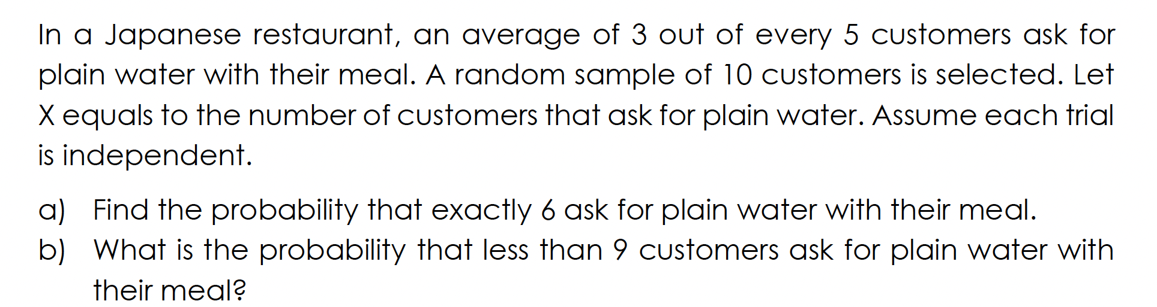
Exercise #4
c) On one night, the manager finds out that 5 customers ask for plain water. If the probability of customer asking for plain water is the same in all other nights, what is the probability that 11 customers asking for plain water in the next night?

Slide 56
Exercise #5
In an NBA (National Basketball Association) championship series, the team that wins four games out of seven is the winner. Suppose that teams A and B face each other in the championship games and that team A has probability 0.55 of winning a game over team B.
What is the probability that team A will win the series in 6 games?
What is the probability that team A will win the series?
If teams A and B were facing each other in a regional playoff series, which is decided by winning three out of five games, what is the probability that team A would win the series?

Slide 57
Properties of Geometric Distributions:
Geometric Distribution
The trial is independent.
Each trial can result in one of two possible outcomes, success and failure.
The probability of success is the same for all trials.
A geometric random variable x is defined as
x = number of trials UNTIL the FIRST success is observed ( including the success trial).

Slide 58
Geometric Distribution (cont.)
Geometric distribution is in a sense INFINITE. They’re asking you what is the probability UNTIL the first success happens.
Example:
Malik throws a dice until he gets a ‘4’.
What is the probability of him getting the first ‘4’ in the 6th throw? How to calculate the probability?

Slide 59
Geometric Probability Distribution function:
Geometric Distribution (cont.)
If x is a random variable with probability of success = p for each trial, then

Slide 60
Formulas for mean and standard deviation of a geometric distribution:
Geometric Distribution (cont.)

Slide 61
Example
A product produced by a machine has a 3% defective rate. What is the probability that the first defective occurs in the fifth(5th) item inspected?
Solution:

Slide 62
Exercise #6
It is claimed that 15% of the ducks in a particular region have patent schistosome infection. Suppose that seven ducks are selected at random. Let x equals the number of ducks that are infected.
a) Assuming independence trials, how is x distributed?
b) Find the probability that:
i) At most two ducks are infected.
ii) One duck is not infected.
c) A new drug is proposed to treat the schistosome infection. Therefore, the infected duck is randomly selected. What is the probability that the first duck infected is found at the fifth trial?
62

Slide 63
Exercise #7
A company fabricates special-purpose robots and records show that the probability is 0.10 that the one of its new robots will require repairs during confirmation tests. What is the probability that the eighth robot it builds in a month is the first one to require repairs?

Slide 64
Continuous Distribution

Slide 65
Continous Distribution
Symmetrical bell-shaped (unimodal) density curve defined by m and s
Area under the curve equals 1.
Probability of observing a value in a particular interval is calculated by finding the area under the curve.
As s increases, the curve flattens & spreads out.
As s decreases, the curve gets taller and thinner.

Slide 66
A
B
σ
σ
Do these two normal curves have the same mean? If so, what is it?
Which normal curve has a standard deviation of 3?
Which normal curve has a standard deviation of 1?
YES
B
A

Slide 67
Effect of Varying Parameters (µ & σ)

Slide 68
Notation
x is N(μ,σ)
The random variable x has a normal distribution (N) with mean, μ and standard deviation, σ.
Example:
x is N(40,1)
x is N(10,5)
x is N(50,3)

Slide 69
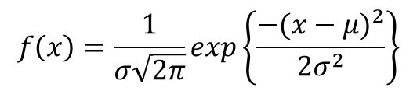
Probability Density Function
Normal Distribution
Parameters: µ and σ
for -∞ < x <∞
x = value of random variable (- < x < )
⬧ = Population Standard Deviation
= 3.14159
e = 2.71828
❍ = Mean of Random Variable x

Slide 70
Normal Curve
Notice that the normal curve is curving downwards from the center (mean) to points that are one standard deviation on either side of the mean. At those points, the normal curve begins to turn upward.

Slide 71
Standard Normal Distribution
Is a normal distribution with µ = 0 and σ = 1
It is customary to use the letter z to represent a variable whose distribution is described by the standard normal curve (or z curve).

Slide 72
Normal Distribution Probability
Probability is area under curve!

Slide 73
Infinite Number of Distribution Tables
Normal distributions differ by mean & standard deviation.
Each distribution would require its own table.
That’s an infinite number!

Slide 74
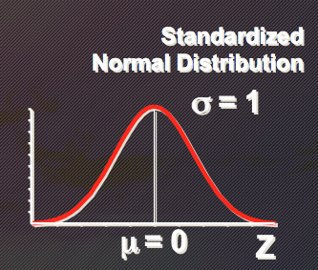
Standardize the Normal Distribution
Normal Distribution
One table!

Slide 75
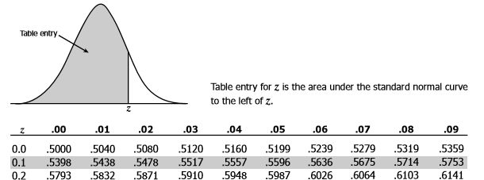
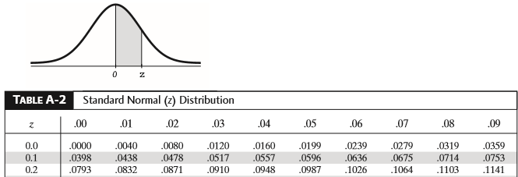
There are 2 type of Z distribution tables:
The probability area is calculated from the very left area
Full Z table
The probability area is calculated from the center area
Half Z table

Slide 76
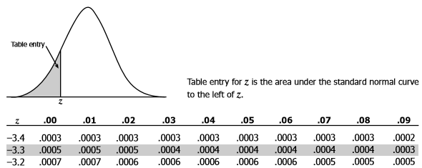
For full Z distribution tables, there are two different tables representing the area:

Slide 77
Example
What is the probability of P(X=6.2), given that the mean is 5 and std. deviation is 10?.
Normal Distribution

Slide 78
Example -Solution
Step 1: Find the Z value.
Normal Distribution
Standardize Normal Distribution
Note: Shaded area exaggerated.

Slide 79
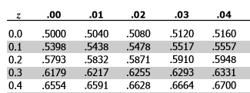
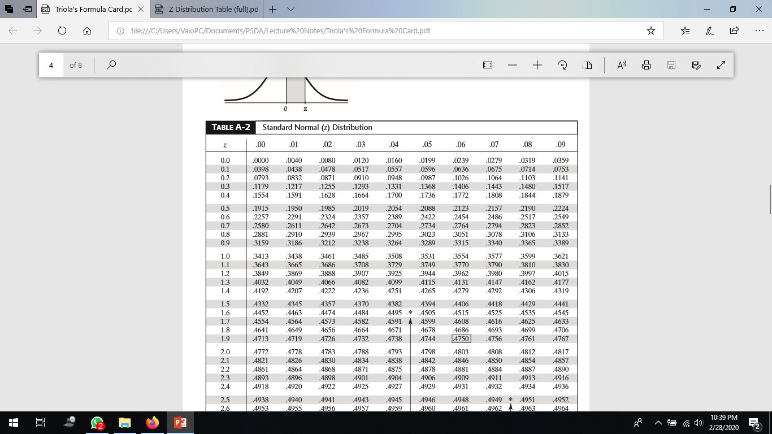
Step 2: Refer to standard Normal Dist. Table to locate the Z value.
0.0478
Standardized Normal Probability Table (Portion)
Full Z Table
Half Z Table
P(Z = 0.12) = 0.5478 - 0.5 = 0.0478

Slide 80
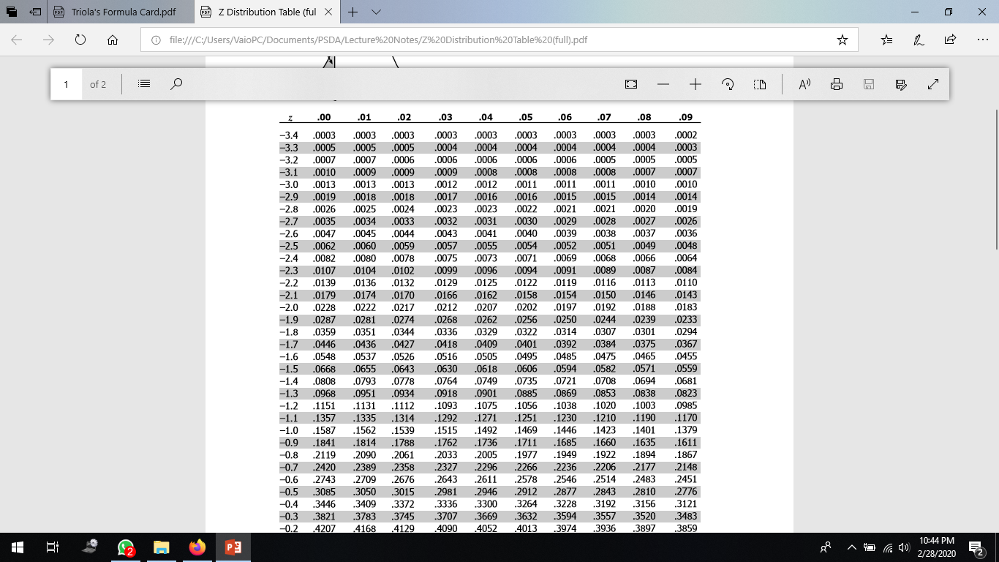
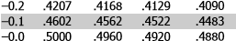
Example: Find P(3.8 ≤ X ≤ 5)
Normal Distribution
Full Z Table
… … … … …
P(Z=0.12) = 0.5 – 0.4522
= 0.0478
Standardize Normal Distribution
0.04776
Half Z Table

Slide 81
Example: Find P(2.9 ≤ X ≤ 7.1)
Normal Distribution

Slide 82
Example P(2.9 ≤ X ≤7.1)
Full Z Table
Full Z Table
… … … … …
P(Z = - 0.21) = 0.5 – 0.4168 = 0.0832
P(Z = 0.21) = 0.5832 – 0.5= 0.0832
Half Z Table
0.0832
0.0832
0.0832 + 0.0832 = 0.1664

Slide 83
Example: Find P(X ≥ 8)
Full Z Table
Half Z Table
P(Z = 0.30) = 1 - 0.6179 = 0.3821
P(Z = 0.30) = 0.5 - 0.1179 = 0.3821
Normal Distribution
Standardize Normal Distribution
0.3821

Slide 84
Example: Find P(7.1 ≤ X ≤ 8)
P(Z = 0.21) = 0.0832
P(Z = 0.30) = 0.1179
P(0.21 ≤ Z ≤ 0.30) = 0.1179 – 0.0832 = 0.0347
Normal Distribution
Standardize Normal Distribution
.1179
0.0347
.0832

Slide 85
Finding Z Values for Known Probabilities
If Z greater than mean, what is Z given that P(Z) = 0.1217?
P(Z=?) = a - 0.5 = 0.1217 => 0.1217 + 0.5 = 0.6217
Full Z Table
Standardize Normal Distribution
0.1217
Half Z Table
?
Note:
If Z less than mean, than Z value has negative sign.

Slide 86
Finding X Values for Known Probabilities
Normal Distribution
Standardize Normal Distribution
.1217
.1217

Slide 87
Exercise #8
1. X is a normally distributed variable with mean μ = 30 and standard deviation σ = 4. Find
P(X ≤ 40)
P(X ≥ 21)
P (18 ≤ X ≥ 35)
2. A radar unit is used to measure speeds of cars on a motorway. The speeds are normally distributed with a mean of 90 km/hour and a standard deviation of 10 km/hr. What is the probability that a car picked at random is travelling at more than 100 km/hour?

Slide 88
Exercise #9
A lecturer commutes daily from his suburban home to his midtown university. The average time for a one-way trip is 24 minutes, with a standard deviation of 3.8 minutes. Assume that the distribution of trip times to be normally distributed.
What is the probability that a trip will take at least ½ hours?
If the office open at 9.00 A.M and the lecturer leaves his house at 8.45 A.M daily, what percentage of the time is he late for work?
If he leaves the house at 8.35 A.M and coffee is served at the office from 8.50 A.M until 9.00 A.M. what is the probability that he missed coffee?
Due to unforeseen incident, the journey takes longer than usual. If 15% is considered as unusual journey time, what is the length of unusual journey time.
Using Binomial distribution, find the probability that 2 of the next 3 trips will take at least ½ hour.

